Slide 1
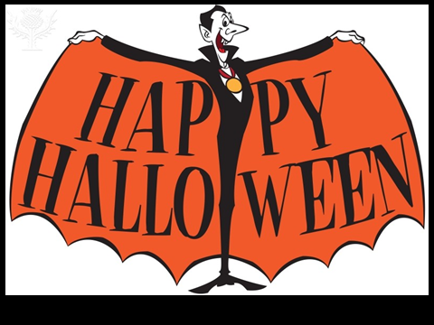
Halloween

Slide 2
字彙、句子
vocabulary sentences
實際活動
social activity
萬聖節
HALLOWEEN
圖像
image
文化背景
background information

Slide 3
Origin of Halloween
Halloween began as an ancient Celtic festival in Great Britain and Ireland, and has survived most strongly among Irish, Scottish and Welsh communities. Immigrants from these communities carried the tradition to North America where it has gained in popularity. In turn, as part of American pop culture, Halloween has spread in popularity to most corners of the English speaking western world, and increasingly into Western Europe in recent times.

Slide 4
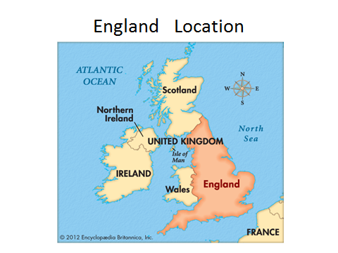
蘇格蘭
北愛爾蘭
愛爾蘭
威爾斯
英格蘭

Slide 5
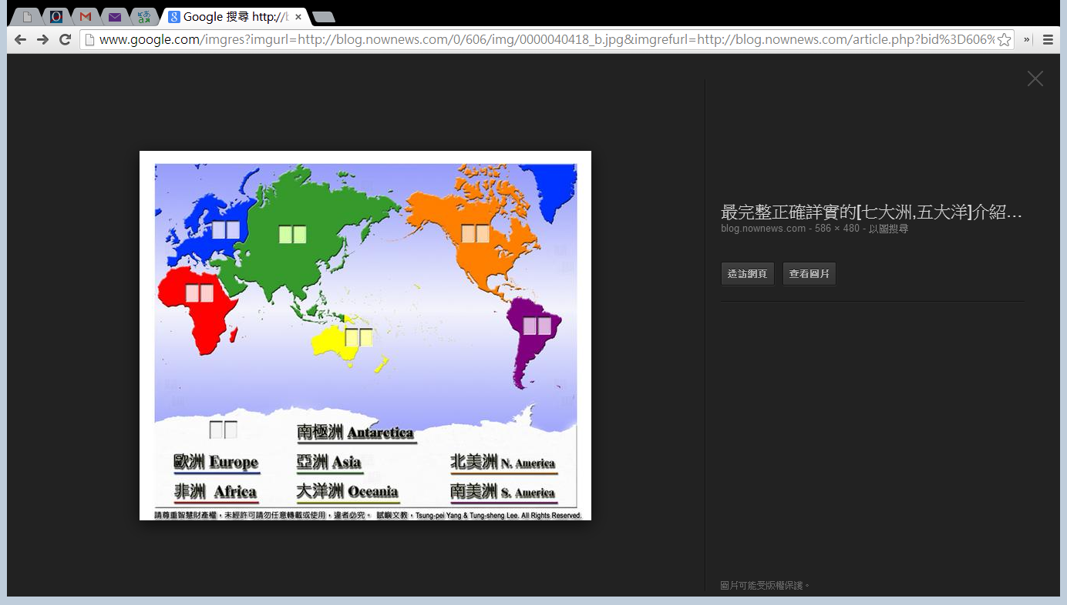
Europe
N.America

Slide 6
Originally Halloween was a pagan festival, around the idea of linking the living with the dead, when contact became possible between the spirits and the physical world, and magical things were more likely to happen. Like most pagan festivals, long ago it was absorbed into the festivals of the expanding Christian church, and became associated with All Hallows Day, or All Saints Day, which eventually fell on November 1 under the Gregorian calendar. A vigil for the festival was held on All Hallows Evening on October 31. In the vernacular of the times, All Hallows Evening became Halloween and later the Halloween we know today.

Slide 7
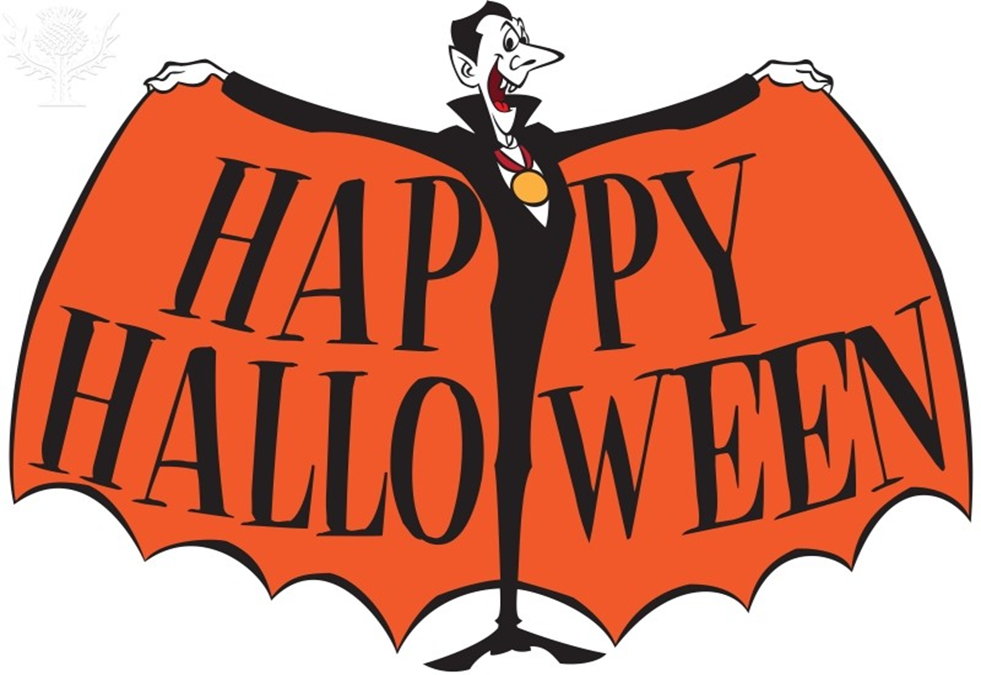
Halloween

Slide 8
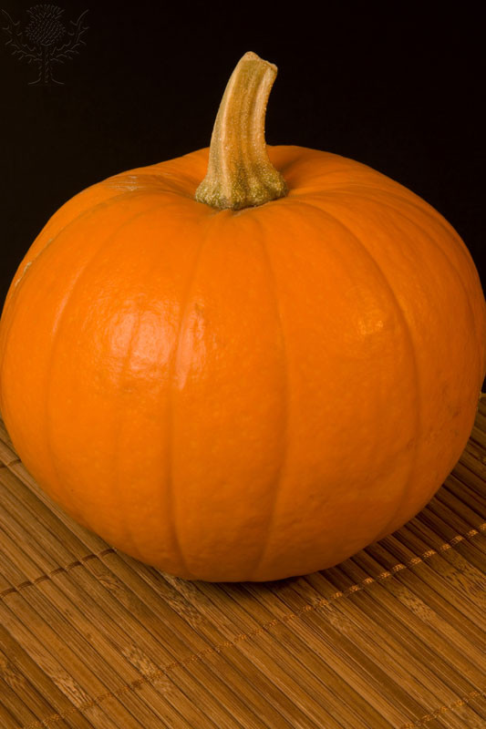
pumpkin

Slide 9
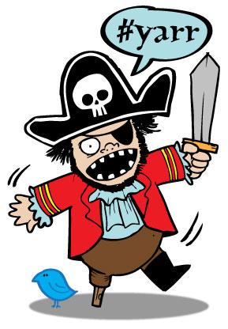
pirate

Slide 10
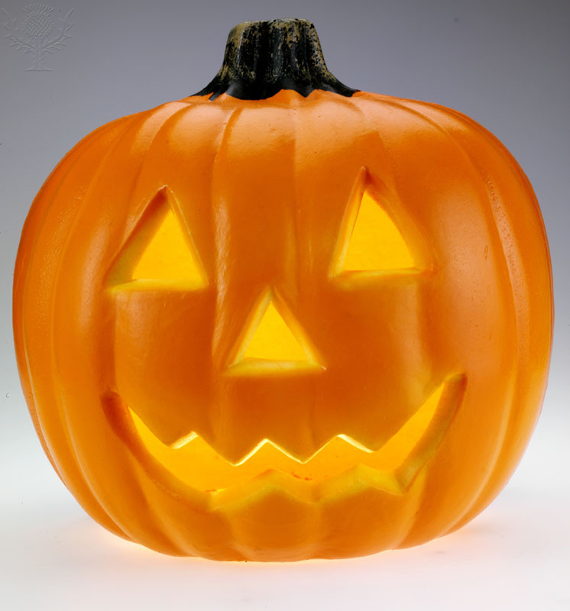
Jack-O’-Lantern

Slide 11
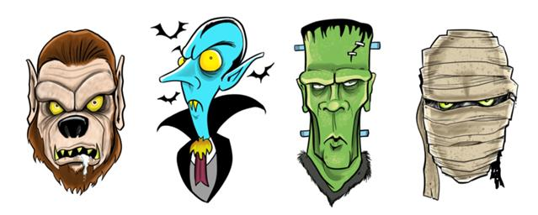
monster

Slide 12
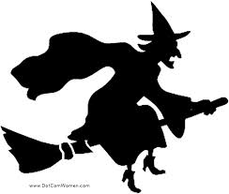
witch

Slide 13
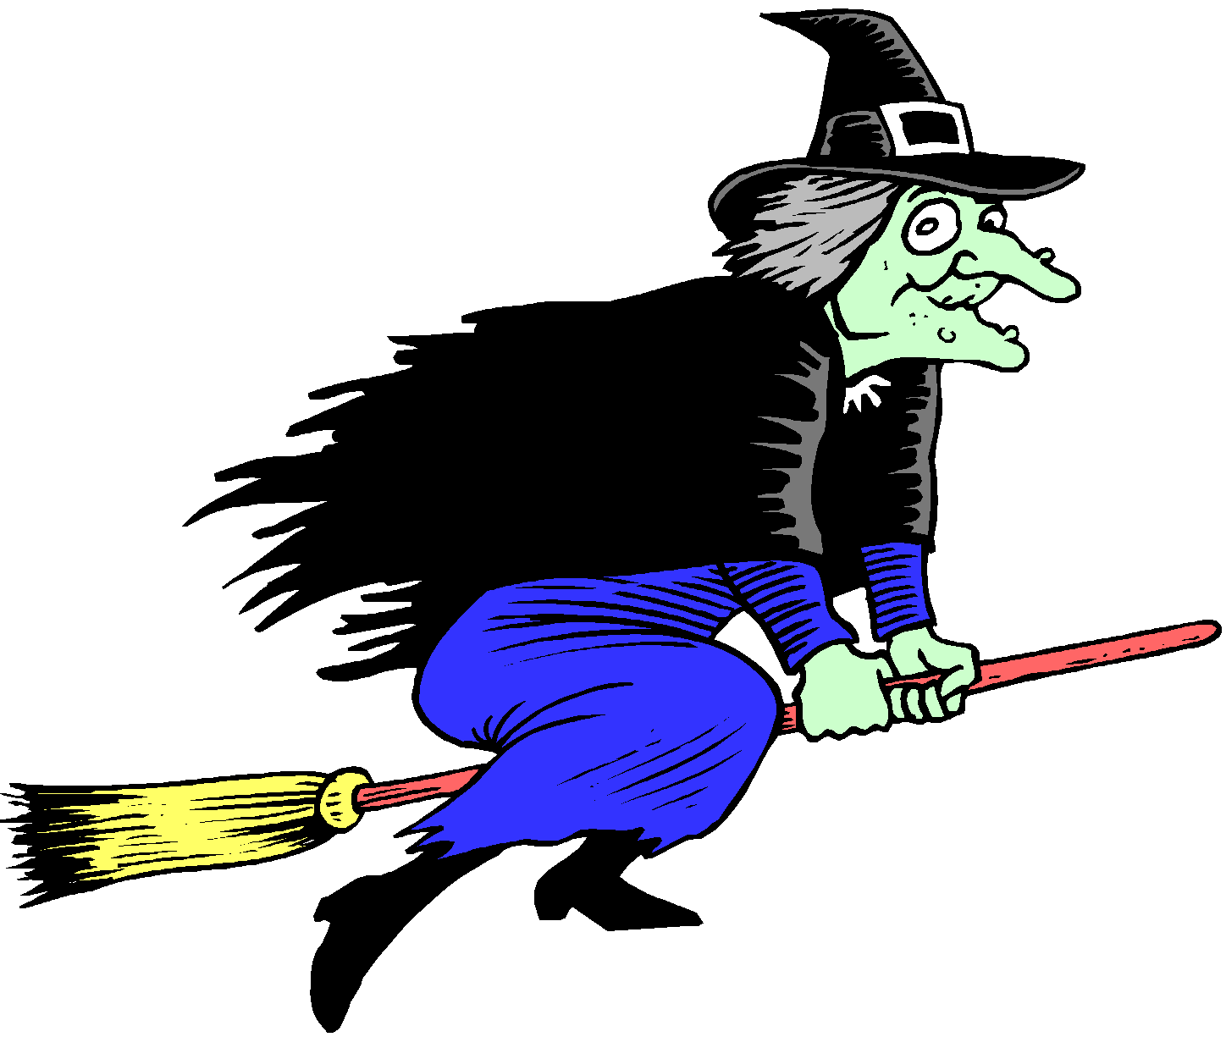
witch

Slide 14
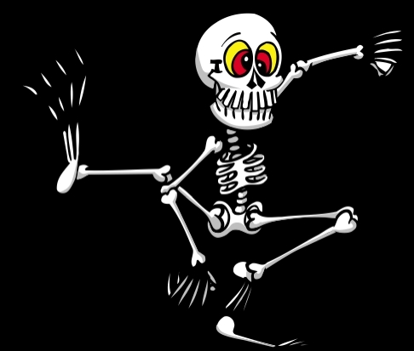
skeleton

Slide 15
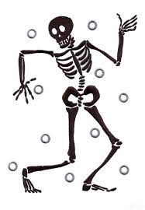
bones
9.head
8.hand
7.neck
6.back
5.hip
4.tight
3.knee
2.leg
1.foot

Slide 16
skeleton

Slide 17
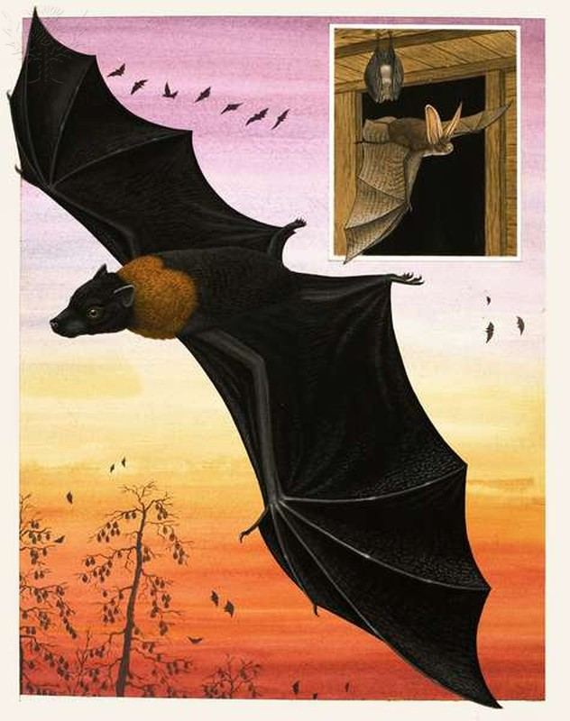
bat

Slide 18
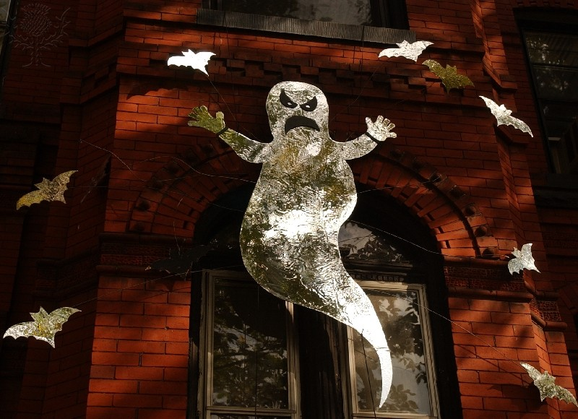
ghost

Slide 19
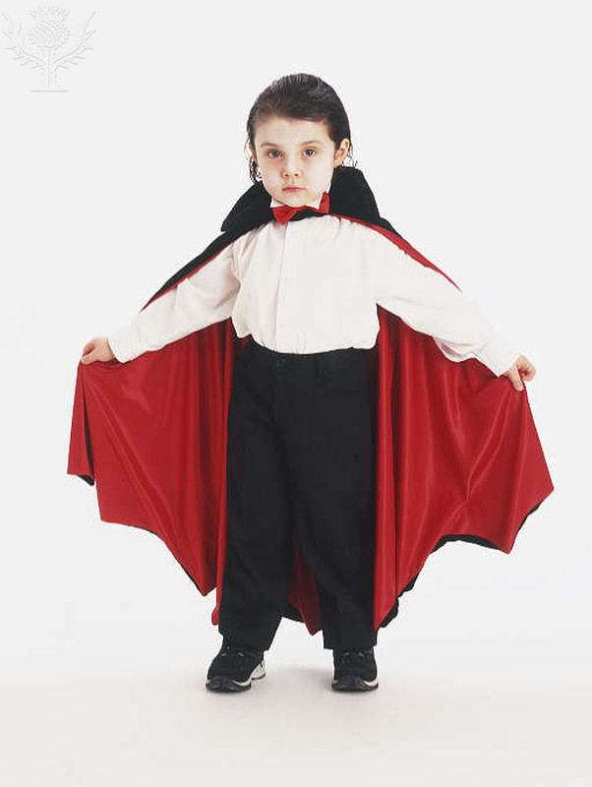
vampire

Slide 20
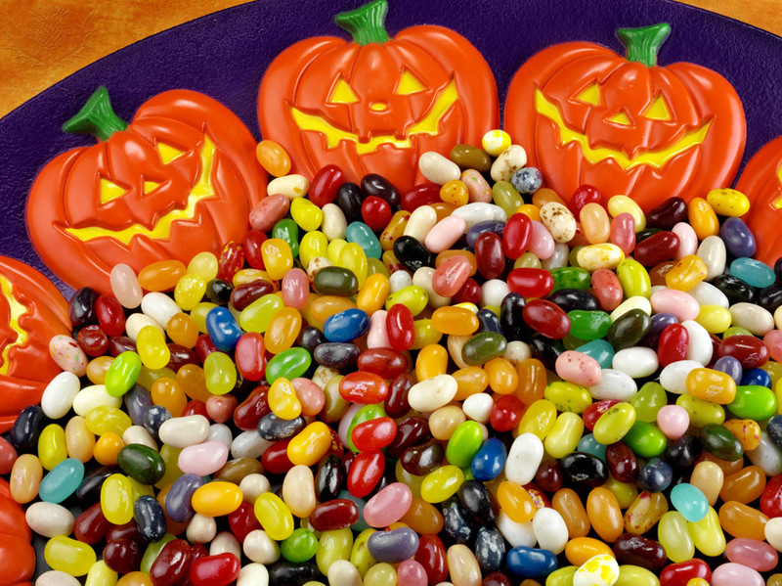
candy

Slide 21
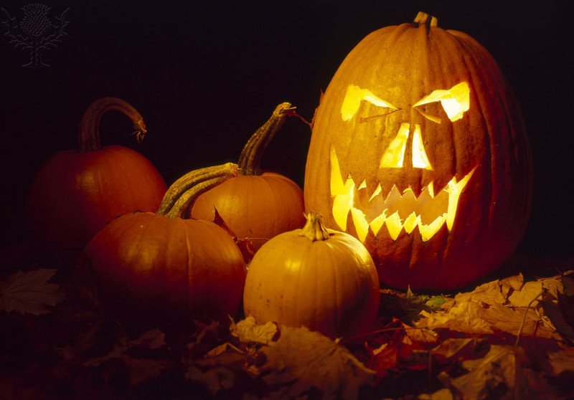

Trick or treat, smell my feet.
Give me something good to eat.
Happy Halloween! https://www.youtube.com/watch?v=JsyEX9iIN-I https://www.youtube.com/watch?v=4coi65CT1G4 https://www.youtube.com/watch?v=wUzVpYMuEjo https://www.youtube.com/watch?v=Jpvuqj5nv6U
Song time~

Slide 22
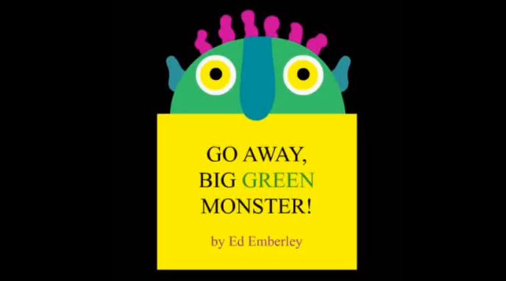
Story time https://www.youtube.com/watch?v=rPmLZLp-oec

Slide 23
Bingo game !

Slide 24
1 | 2 | 3 | 4
5 | 6 | 7 | 8
9 | 10 | 11 | 12

Slide 25

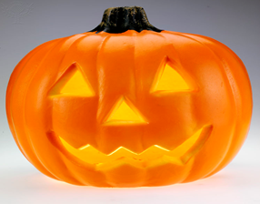

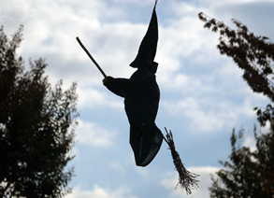


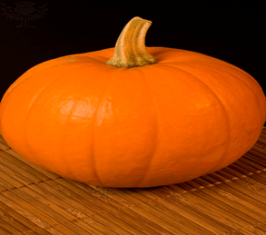



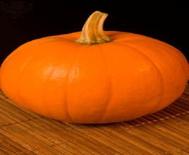

1 | 2 | 3 | 4
5 | 6 | 7 | 8
9 | 10 | 11 | 12

Slide 26


1 | 2 | 3 | 4
5 | 6 | 7 | 8
9 | 10 | 11 | 12

Slide 27
Rules of game
1.Every group has a map which shows 24 places.
And you can find 24 Halloween bingo words (on pink
papers) in the 24 places.
2.You have to complete the Halloween Bingo (three
lines.)
3.When you find one Halloween bingo word, the whole
group should play the role of this Halloween word in
the front of teachers, and then you can get the
certification from teachers.

Slide 28
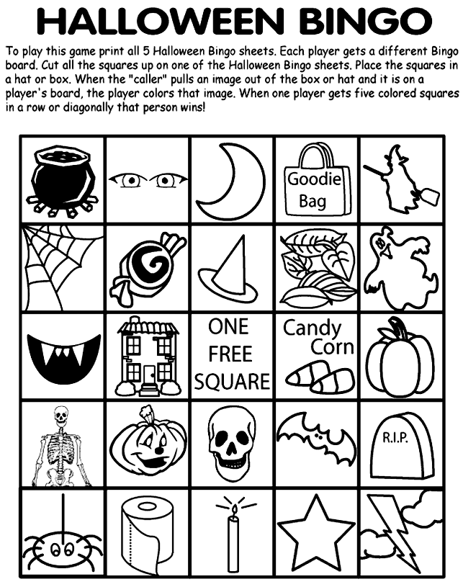

Slide 29
cauldron | Eye patch | moonlight | Goodie bag | Witch
Spider web | Candy | Hat | Leaf | Ghost
Vampire | Haunted house |  | Candy corn | Pumpkin
Skeleton | Jack-o’-lantern | Skull | Bat | Tomb
spider | tissue | candle | star | flashlight

Slide 30
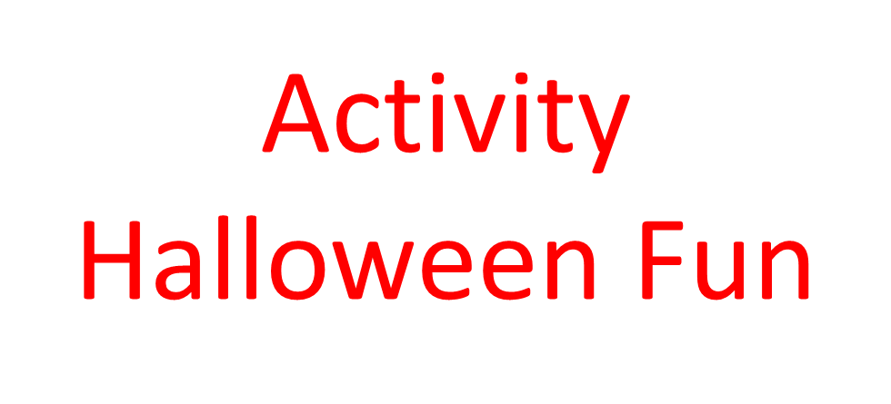

Slide 31
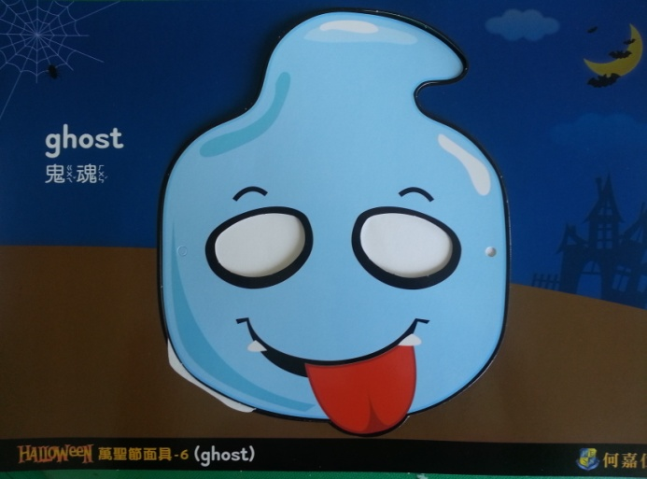
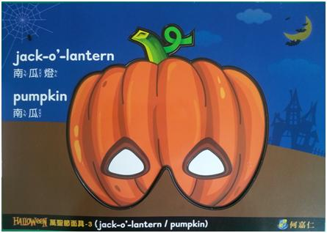
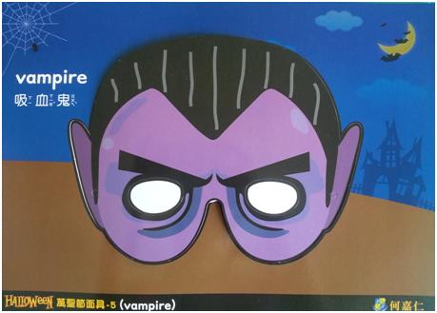
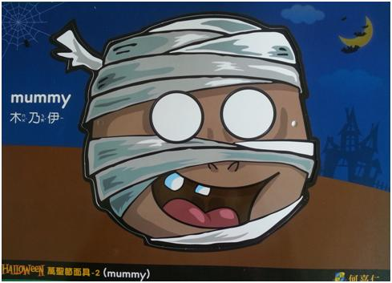
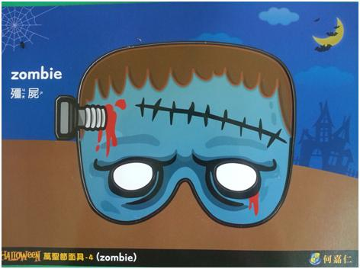
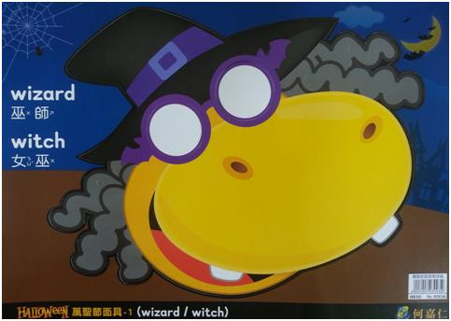
Mask Making

Slide 32
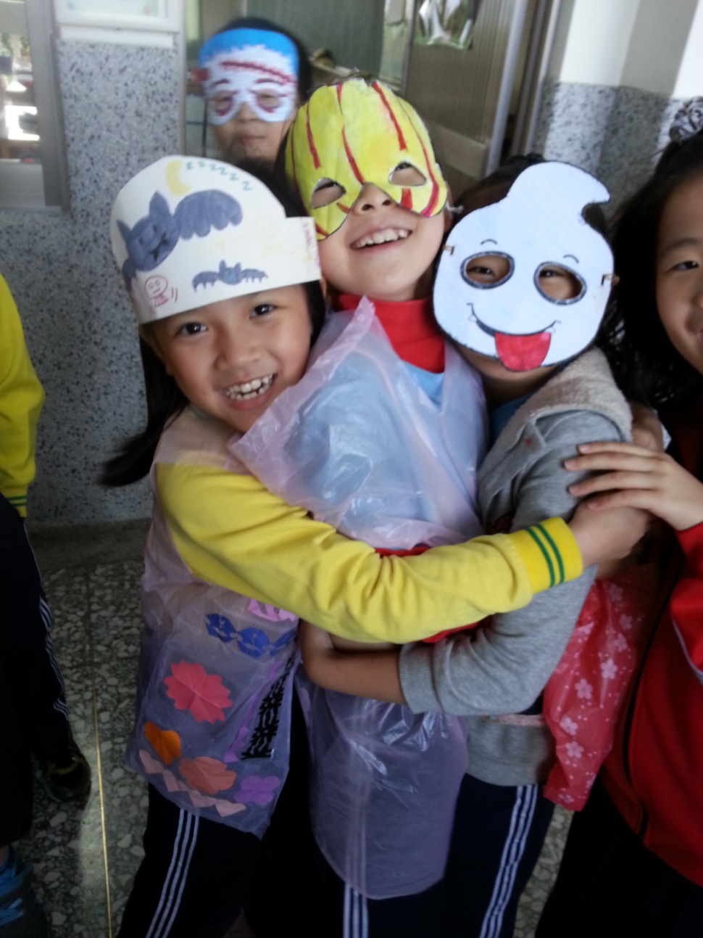
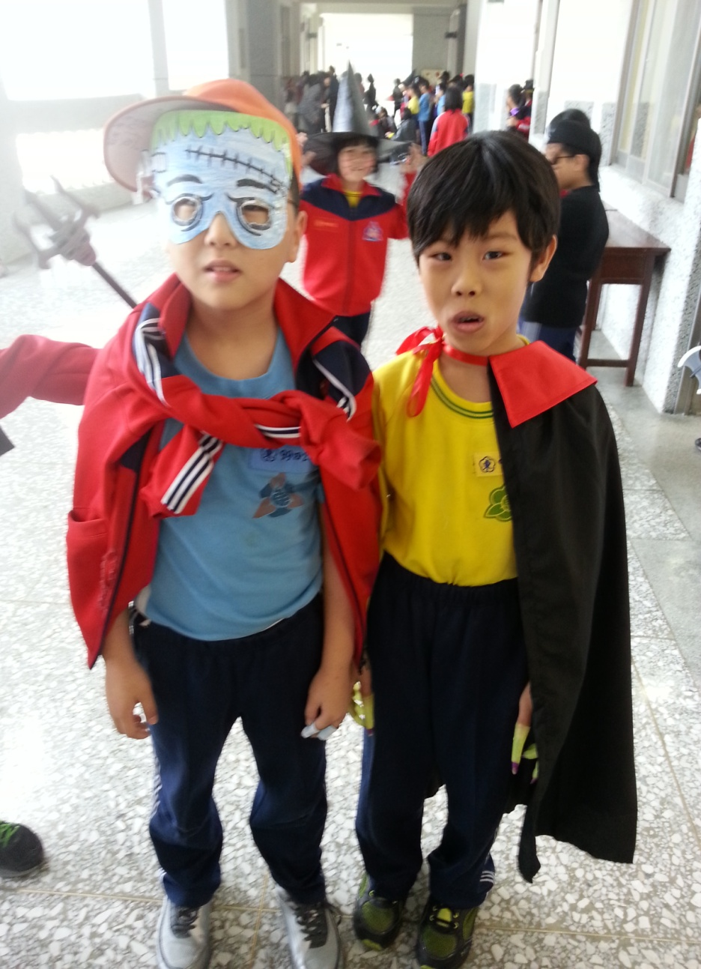
Trick-or-treaters!

Slide 33
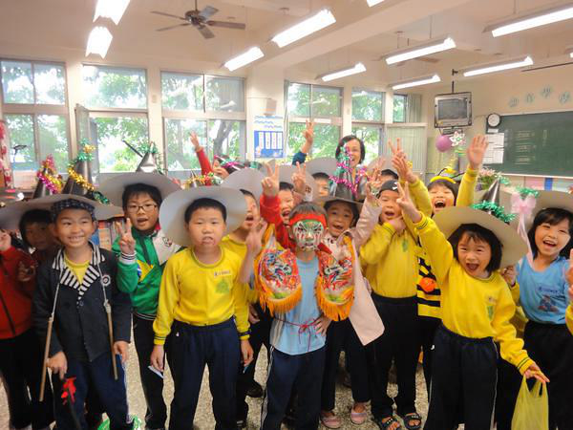

Slide 34
*Understanding the History of Halloween : Jack-o-Lanterns in Halloween History
http://www.youtube.com/watch?v=dcpeiEgi9Z8
*The Origin of Halloween
http://www.youtube.com/watch?v=gVnyGcJqvGs
*Halloween Awakening
http://www.youtube.com/watch?v=aQd0ELH7SNI&feature=fvst
*Halloween Light Show 2010 HD - Thriller
http://www.youtube.com/watch?v=GUAV_1jBJB4&feature=fvst
*Soul Eater This Is Halloween
http://www.youtube.com/watch?v=8mPDh5J37h0

